Slide 1
Special Sensor
CMU Camera 3
Hard 1
John Kurien
3/19/09
Instructors: A. Antonio Arroyo, Eric M Schwartz
TAs: Thomas Vermeer, Mike Pridgen

Slide 2
Outline
Introduction
  Plays Paper Football Against Human
Integrated System
Mobile Platform/Actuation
Sensing and Behavior
Experimental Layout and Results
Conclusion

Slide 3
Integrated System

Slide 4
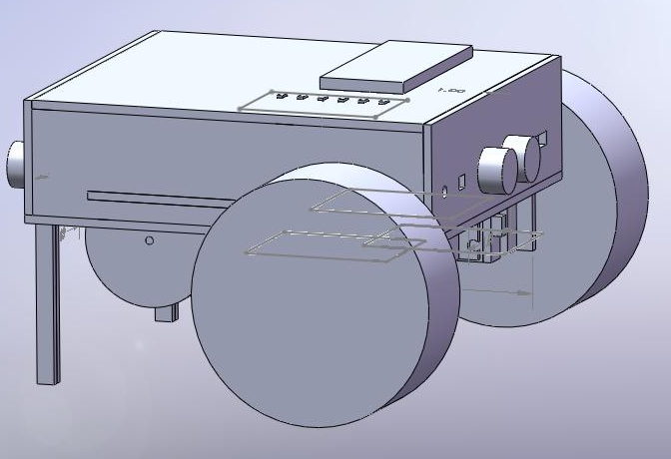
Mobile Platform/Actuation
Camera will be mounted on top of the robot in the front
Camera will tilt by being mounted to a servo

Slide 5
Sensing and Behavior
Hardcode the color of the football
Use the track function to track the football
Use edge detection to determine orientation of football

Slide 6
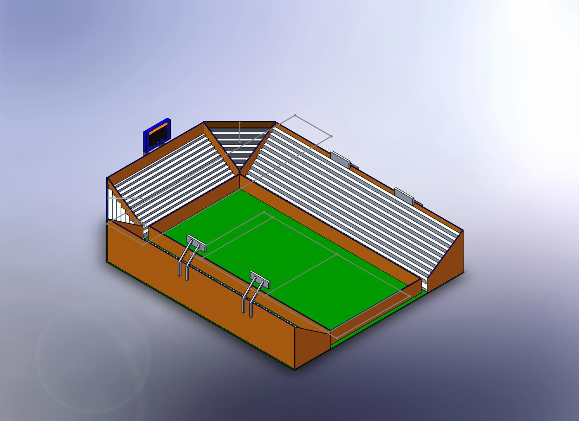

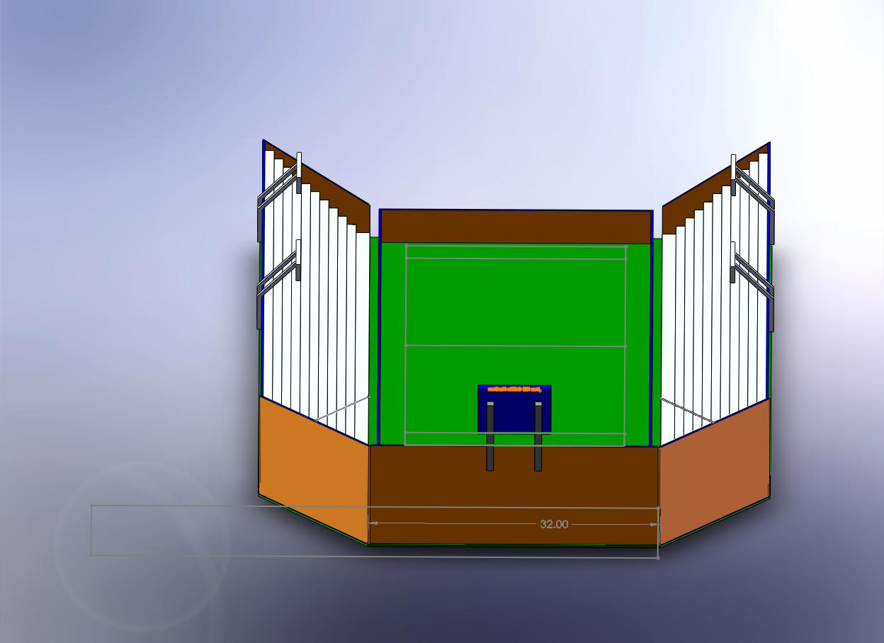
Sensing & Behavior (Environment)

Slide 7
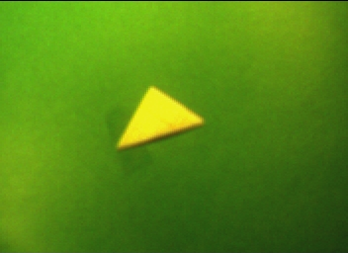
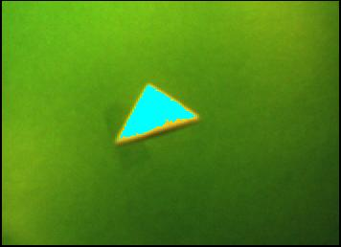
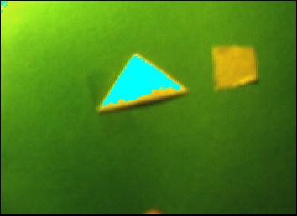
Experimental Layout & Results
Original Grabbed Frame
Color Track
Color Track with possible confusion

Slide 8
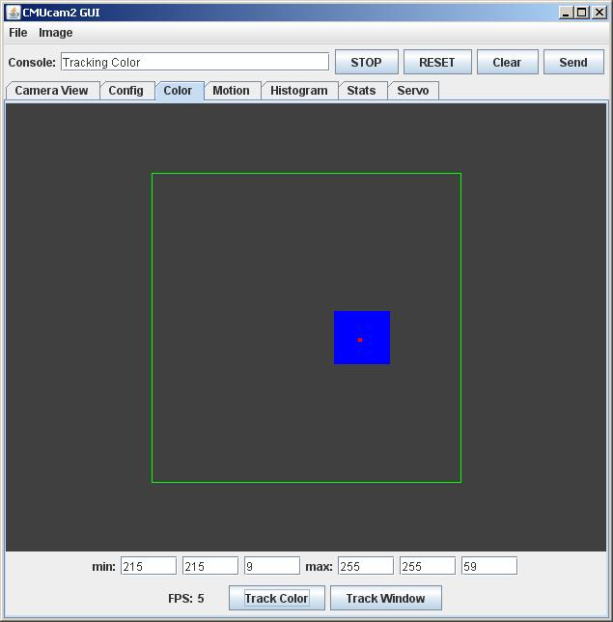
Actual Color Tracking

Slide 9
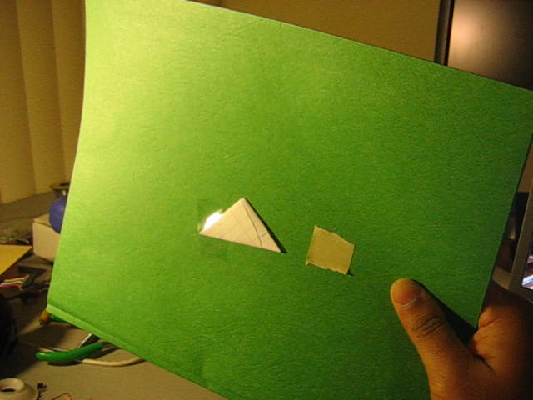

Slide 10
Conclusion
CMU Cam 3 looks to be a good choice
Software seems reliable and functional for my requirements
Always the option of writing my own software

