Slide 1
IMDL Proposal
Hard 1
John Kurien
2/26/09
Instructors: A. Antonio Arroyo, Eric M Schwartz
TAs: Thomas Vermeer, Mike Pridgen

Slide 2
Outline
Paper Football Robot Operation
  Plays Against a Human Opponent
Integrated System
  Inputs (Sensors)
  Outputs (Actuators)
Progress

Slide 3
Introduction
Robot Will Play Paper Football Against a Human Opponent
Touchdowns and 2 Point Conversions (No Field Goals)
Plays with Adjusted Paper Football Association Rules

Slide 4
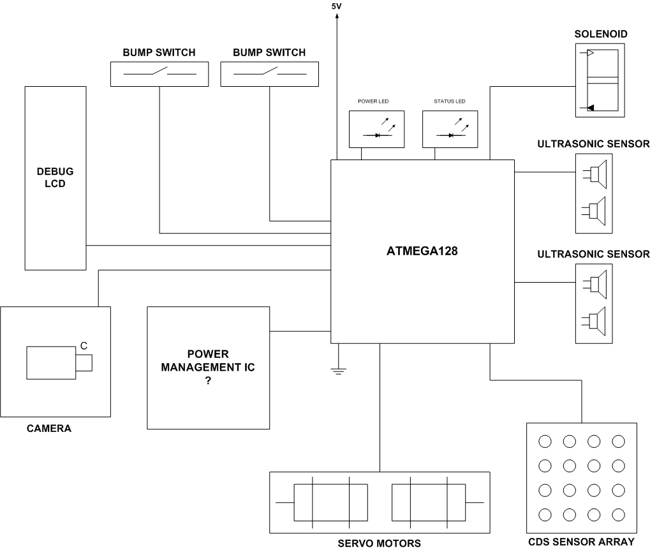
Integrated System

Slide 5
Behavior
On Defense
  Robot Hides (Staying Off the Playing Field)
On Offense
  Identify the Ball
  Move Atop the Ball
  Strike the Ball

Slide 6
Progress
Already Developed
  LCD Driver Code
  Hacked Servos
  Ultrasonic Sensor Drivers
  Platform Design and Fabrication
Soon to be Developed
  CMUCam3 software to identify football
  Purchasing of Solenoid

