Slide 1
Final Presentation
Tim TeBOT
John Kurien
4/14/09
Instructors: A. Antonio Arroyo, Eric M Schwartz
TAs: Thomas Vermeer, Mike Pridgen

Slide 2
Outline
Stadium
Robot
Then Last Night Happened…

Slide 3
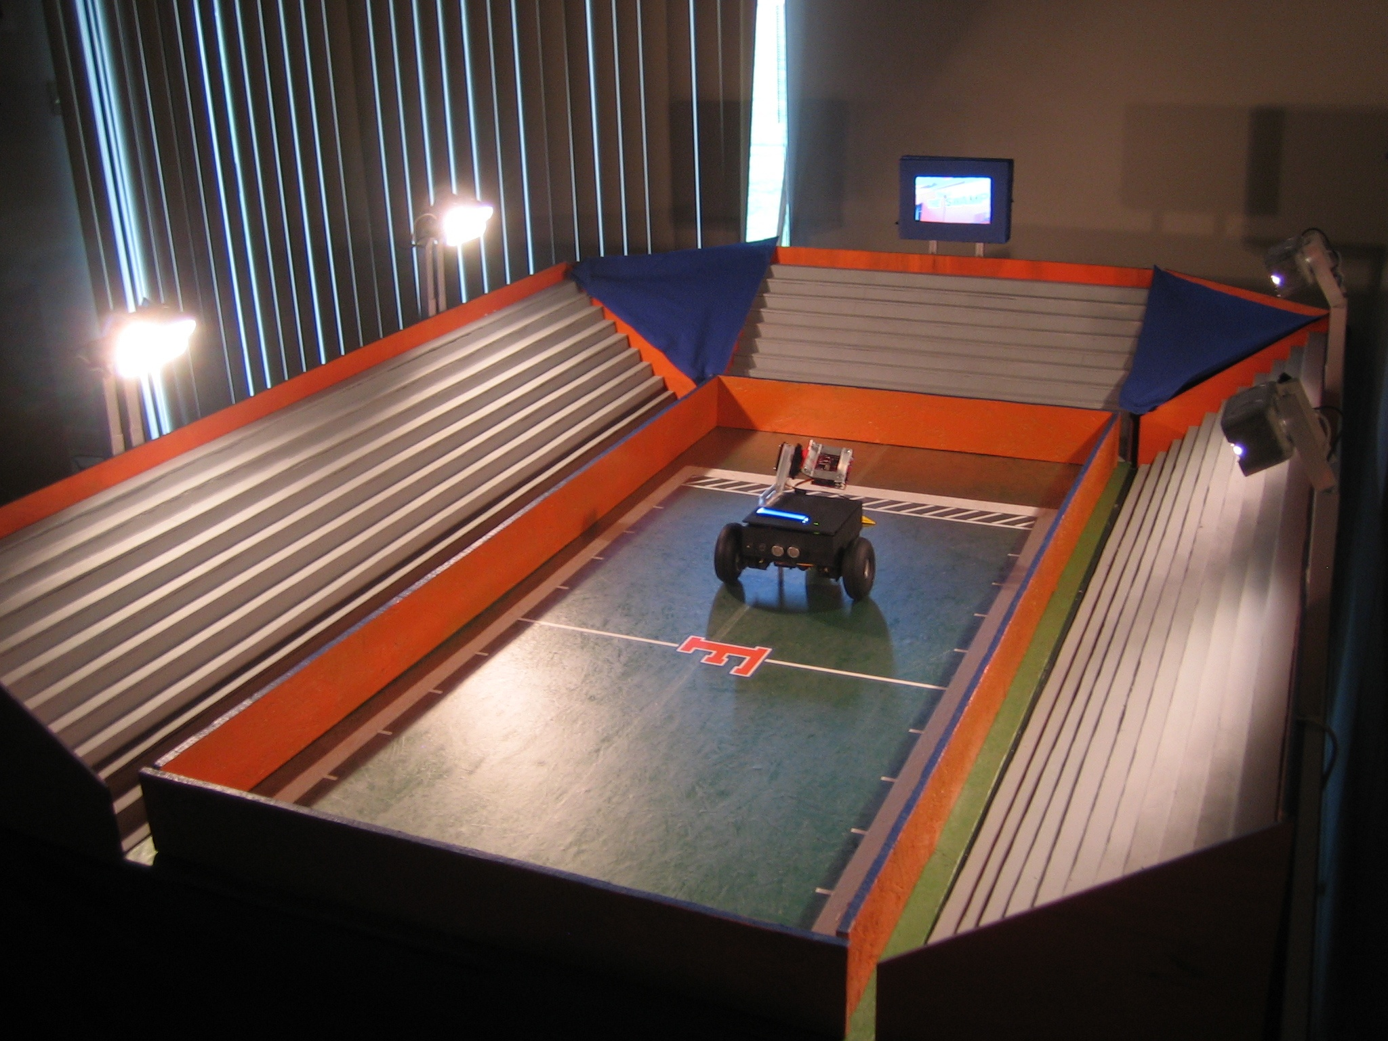
Stadium
JUMBOTRON
SLICK SURFACE
LIGHTING
Stadium
Robot
And then last night happened…
Conclusion
OPEN END FOR HUMAN

Slide 4
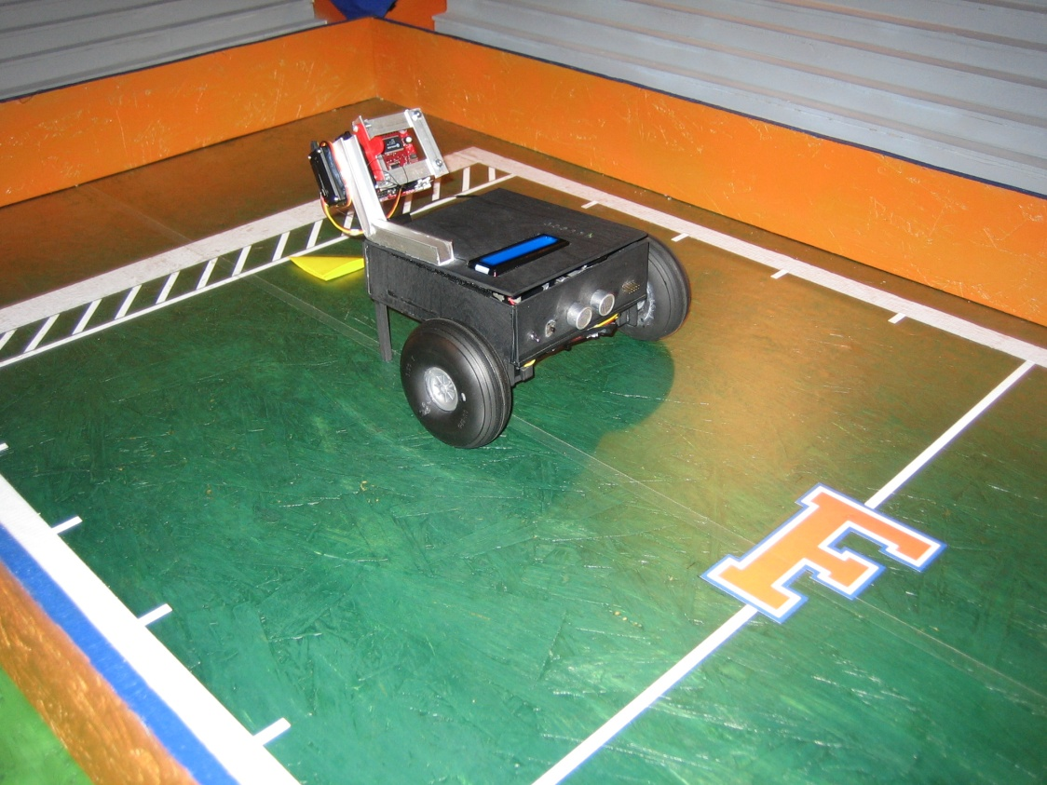
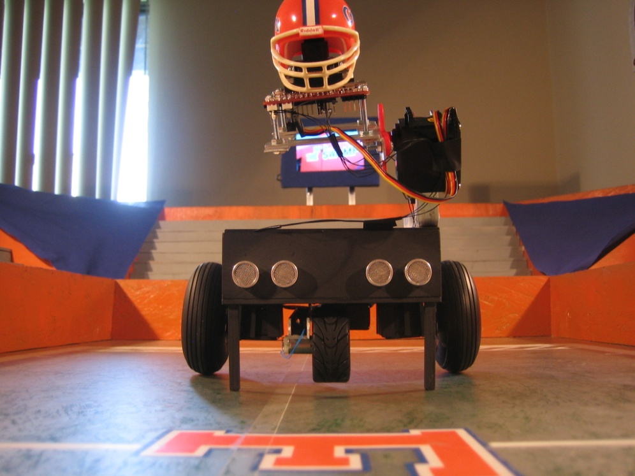
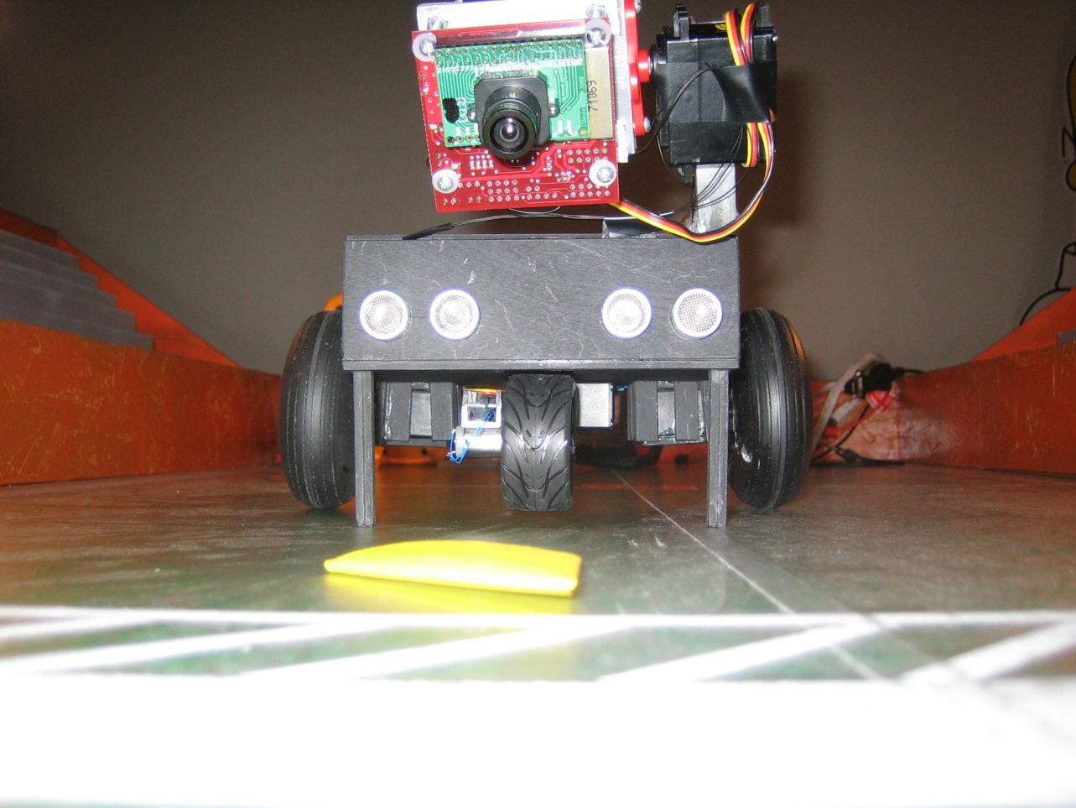

Slide 5
Then Last Night Happened…
CMU Cam will not receive any commands issued from either MCU or Hyperterminal
Cannot track ball anymore

